Slide 1
Please make a copy!
File -> Make a Copy
Remember to include your workbook and this presentation in your submission!

Slide 2
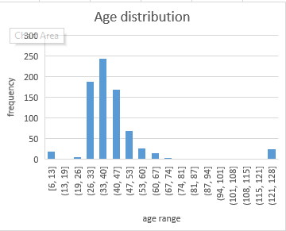
Which Age group have highest participation in survey?
<visualization or summary statistics used for finding>
As shown from histogram that the largest age range is from 33-40 which indicate that most people in that age aim to increase their knowledge about some field of study and followed by 26-33 age which in the beginning of their change from junior to senior positions in their companies.
Standard deviation is 17 so it indicate that there outliers in data

Slide 3
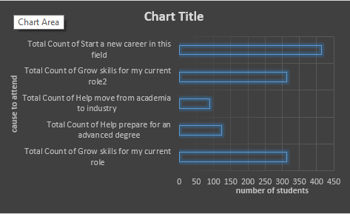
What is the largest causation to attend respondant programs for students ?
<visualization or summary statistics used for finding>
From the car chart we find that the most cause to attend nanodegrees is to start anew carrer in that field
Also the second cause to attend is grow skills

Slide 4
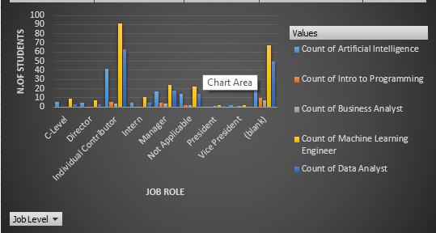
Which job role have largest attending numbers in Nanodegrees ?
<visualization or summary statistics used for finding>
From bar chart we find that individual contributor have the largest attending values especially in artificial intelligence and data analyst nanodegree
Director job level have the second value in data analyst nanodegree which define how this important for them
Lowest contribution is for introduction to programming

Slide 5
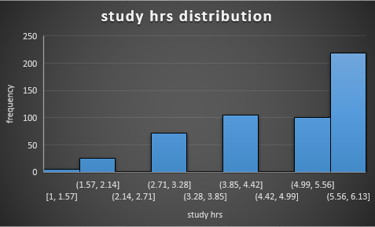
According to study hours which is the range of study hrs in that survey data?
<visualization or summary statistics used for finding>
As shown in graph that most of students have 5 to 6 study hrs per day and also then 5 hrs that ensure importance and attension of students to learn quickely from ateending those nanodegress.
Mean is 4.7
Median is 5
Mode is 6
So we can see that the data is left skewed as mode is leager than median and median larger than mean
Also standard deviation is 1.3 which not large enough to say that the data have outliers

